Slide 1
Top 10 Things You Won’t Recognize

Slide 2
10
Phone Book

Slide 3
9
TV Guide

Slide 4
8
Rotary Phones

Slide 5
7
Video Rental Store

Slide 6
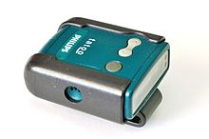
6
Pagers/Beepers

Slide 7
5
Portable/Audio Player
Walkman
discman

Slide 8
4
Video Cassette Recorder
VCR

Slide 9
3
Developing Photographic Film

Slide 10
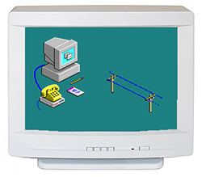
2
Dial-up Internet

Slide 11
1
Floppy Disk

